Slide 1

A Capstone project presentation on A comparative analysis of weapon detection using various deep learning techniques. under the course capstone project Prepared by Group No. 13
K. E. Society’s
Rajarambapu Institute of Technology, Rajaramnagar
Sr. No. | Name | PRN
1 | Sayma Tamboli | 1903074
2 | Komal Jagadale | 1903085
3 | Shreyas Mandavkar | 1903104
4 | Nitish Katkade | 1903108
Under Guidance of
Prof. T.S.Ruprah

Slide 2
Table of content
Introduction
Problem Statement
Objectives
Methodology
Comparative Analysis
Conclusion

Slide 3
1. Introduction
Weapon detection is currently a very important and intensive issue in terms of public security and safety in general. A crime is illegal to conduct that is penalized by law. Because there is so much data on crime, the police agency faces tremendous challenges in analyzing and discovering underlying criminal patterns. It is difficult to recognize weapons of different sizes and forms, as well as different backdrop colors, in the case of weapons detection. Our proposal aims to make police work easier and more efficient when dealing with visual data by detecting weapons.

Slide 4

Problem Statement
In the current scenario of rapidly increasing crime, traditional crime-solving techniques are unable to deliver results. Thus, we have come up with an approach to detect weapons crime on the bases of weapons detection from the scene.

Slide 5
To collect the dataset.
To train the dataset with CNN-based object detection algorithms.
Test the system in a variety of environments and situations to ensure robust performance.
To detect the weapon from the given scene.
Comparative analysis with various models.
Objectives

Slide 6
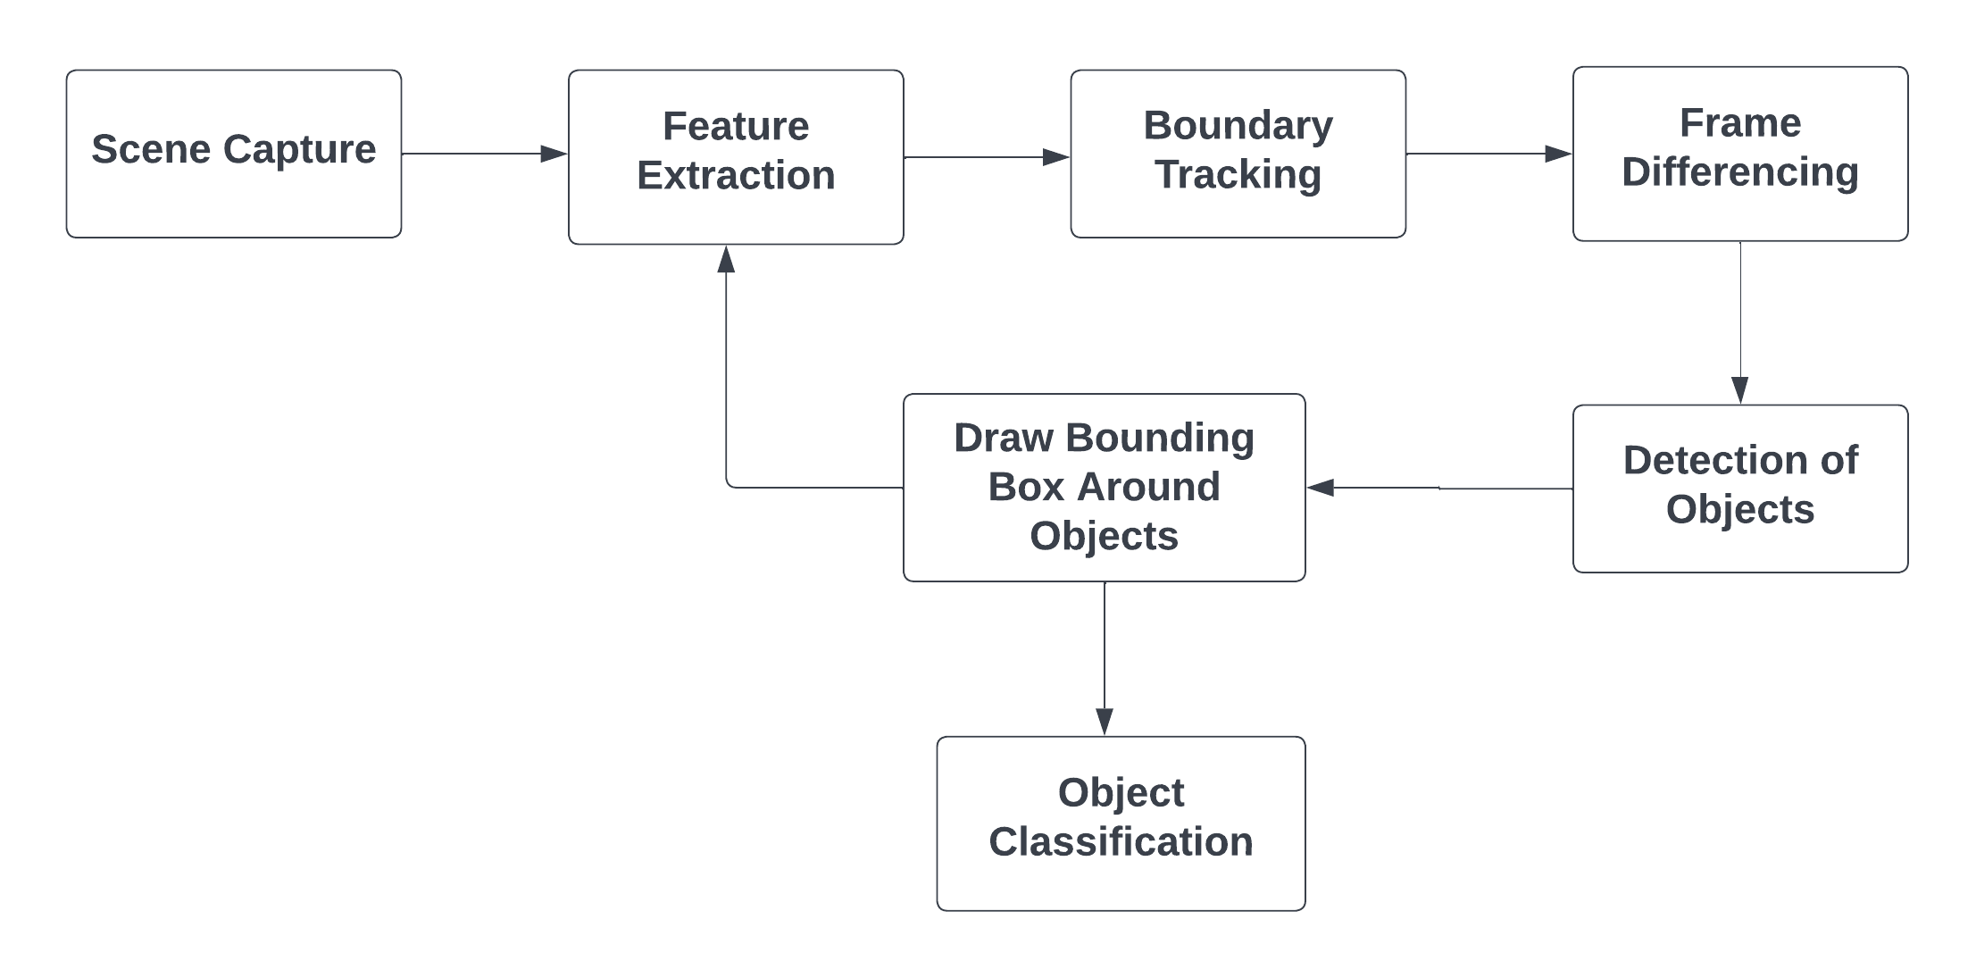
Methodology
The approach addresses weapon detection using various deep-learning algorithms :
Region-based Convolutional Neural Network (RCNN)
You Only Look Once(YOLO v5)
Single Shot Detector(SSD)

Slide 7
MODEL | YOLOv5 | R-CNN | SSD
mAP value (%) (mean Precision Value) | 56.2 | 47.1 | 36.7
Comparative Analysis
As YOLO v5 is most released of the three algorithms it actively being contributed to by the vast open source community. Hence out of the three object detection convolutional neural networks analysed, YOLO v5 shows the best overall performance.

Slide 8
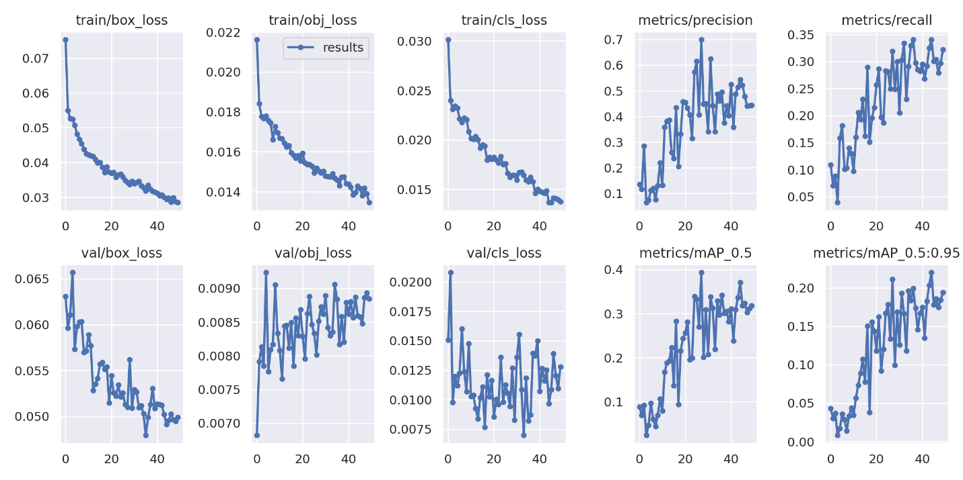
Region-based Convolutional Neural Network (RCNN)
Single Shot Detector(SSD) :

Slide 9
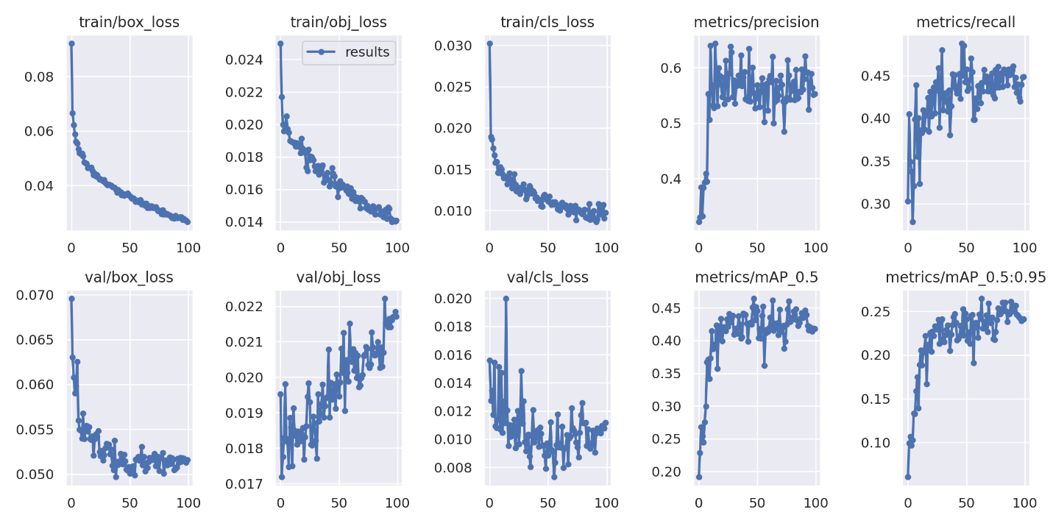
You Only Look Once(YOLO V5)
Single Shot Detector(SSD) :

Slide 10
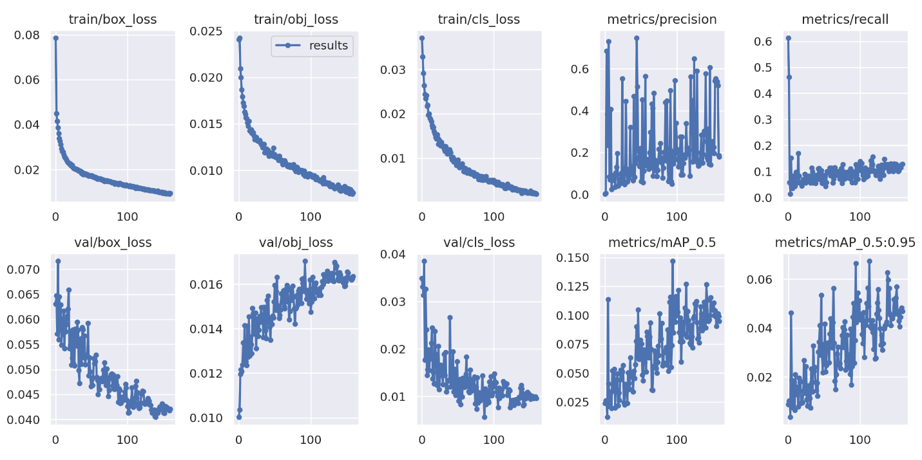
Single Shot Detector(SSD) :
Single Shot Detector(SSD) :

Slide 11

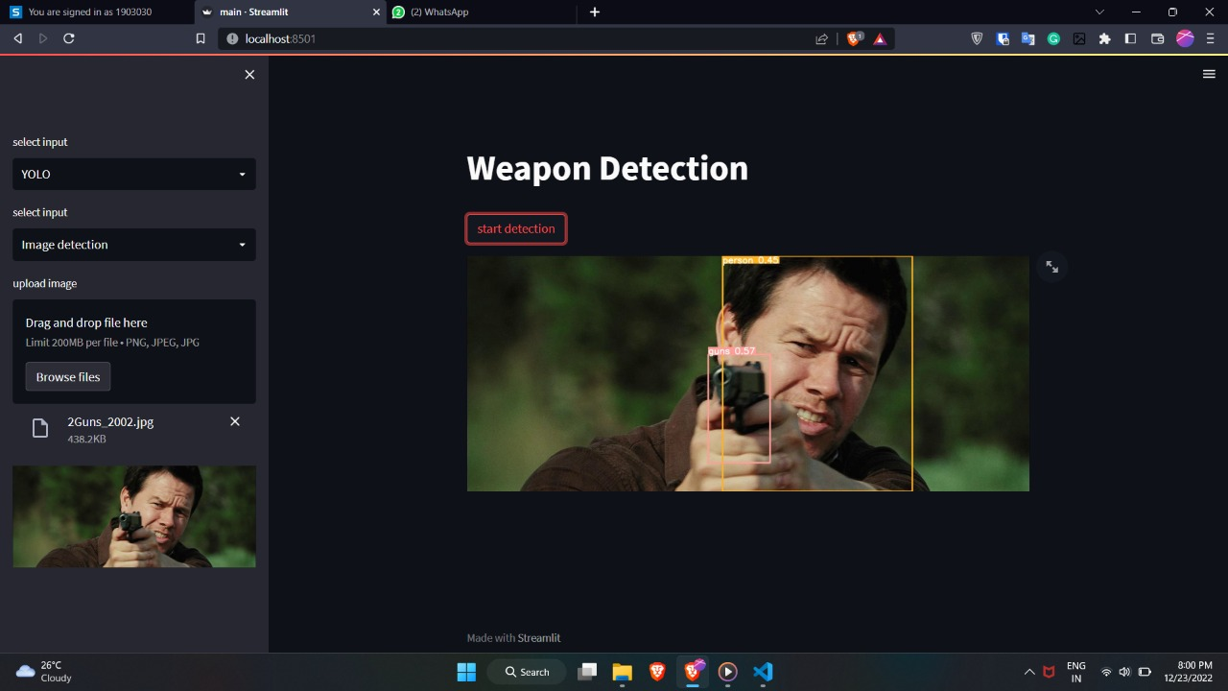
User Interface

Slide 12
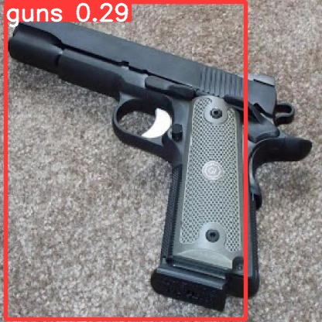
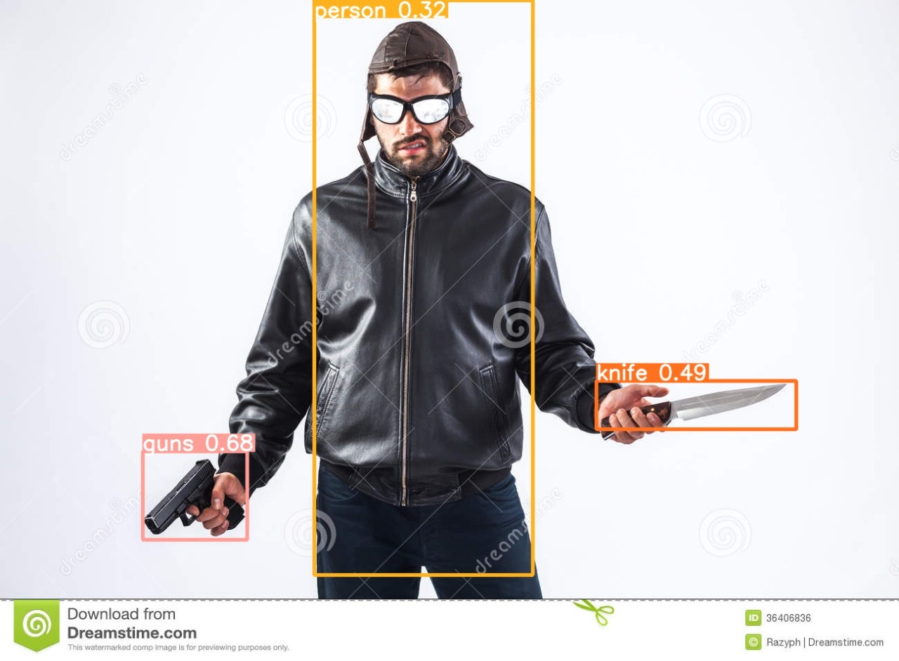
RESULT
YOLO v5

Slide 13
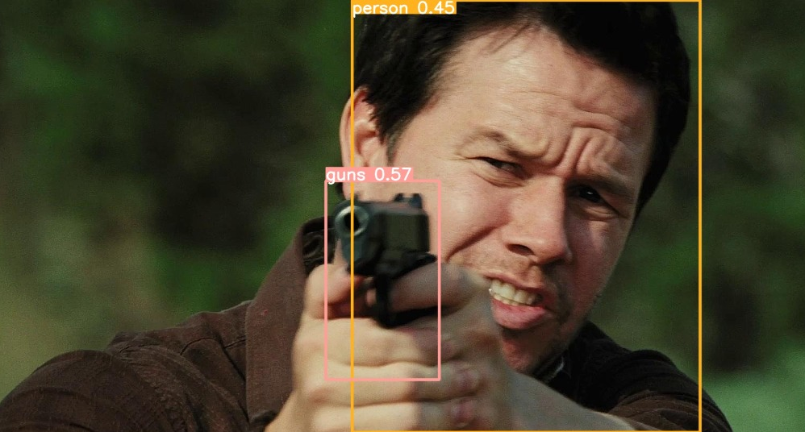
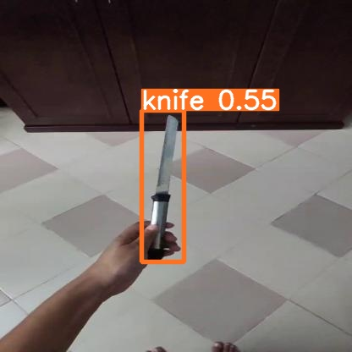
Region-based Convolutional Neural Network (RCNN)

Slide 14
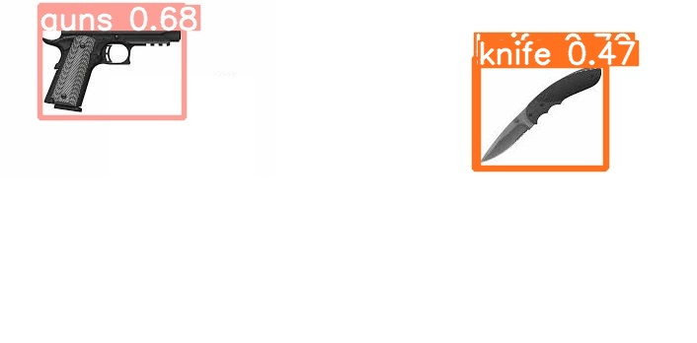
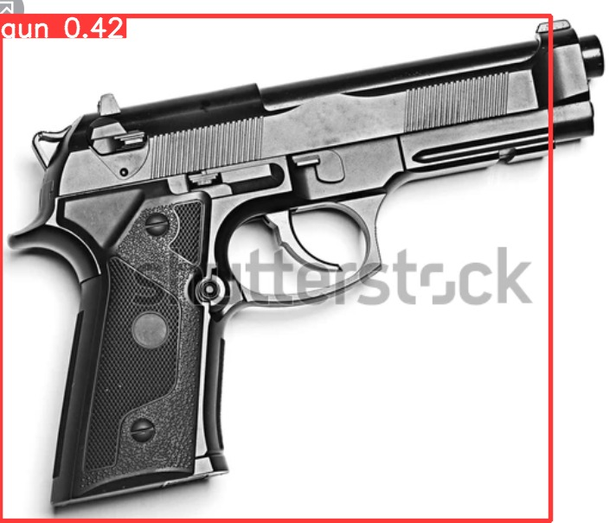
Single Shot Detector(SSD) :

Slide 15
Conclusion
For the implementation of this project, we used the existing technology and libraries available in the world of Image processing and Computer Vision Architecture.
Since we had three models available which were YOLOv5, RCNN, and SSD, we were able to compare the performance of these models on our dataset.
YOLOv5 gave the best prediction accuracy among the two models, although it was considerably slower than RCNN and SSD.
The YOLOv5 model included an affine-tuning approach for the best optimization of the model’s performance.
It is also to be noted that the accuracy we received through R-CNN is not a fixed accuracy that will always be obtained. It primarily depends on the training set size and the variety of training images that are fed to the network.

Slide 16
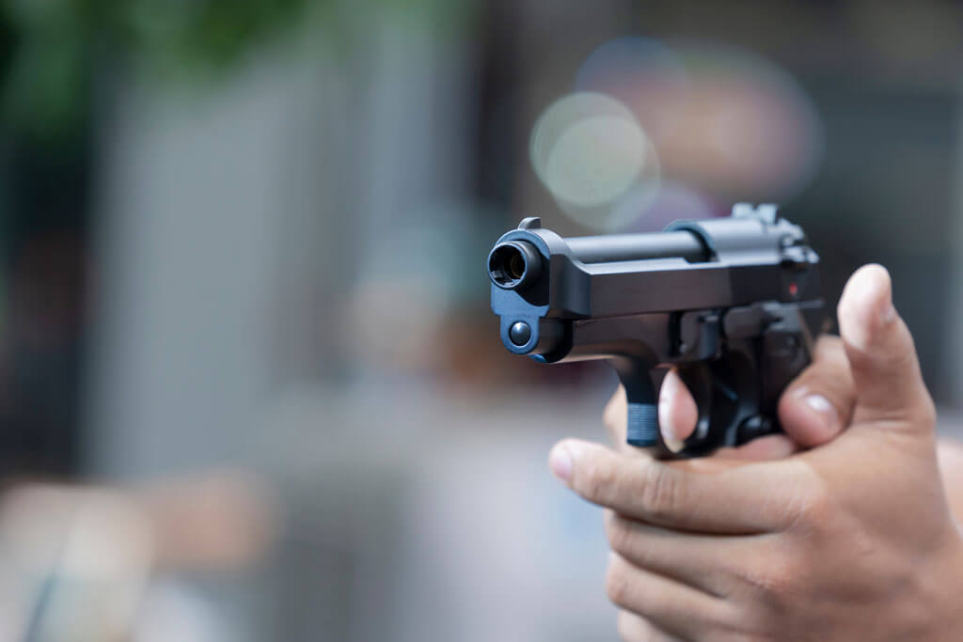
Future Work
1. Detection and Sending alerts to Police/Security team.
2. The algorithm was implemented on images and can be extended to recorded videos by collecting a sequence of frames to detect guns and knives from the video.
3. Installation can be done in cameras/drones for weapon detection.
4. We can predict crime for real-time implementation.

Slide 17
Thank You

